Slide 1


ITI1121A
LAB #4
Friday 11:30 – 14:30
Professor: Nour El-Kadri
TA: Berk Soysal
bsoys096@uottawa.ca
Office Hour: Fridays 15:00 – 16:00
Office Location: SITE 5000D
Download this ppt. - http://uottawa.ml
2016 Winter Prepared by Berk Soysal for ITI1121A

Slide 2
Inheritance is one of the most important features of Object-Oriented Programming (OOP). Inheritance allows a class to get the properties and methods of another class. In other words, the derived class inherits the states and behaviors from the base class. The derived class is also called subclass and the base class is also known as super-class.
Inheritance
2016 Winter Prepared by Berk Soysal for ITI1121A

Slide 3
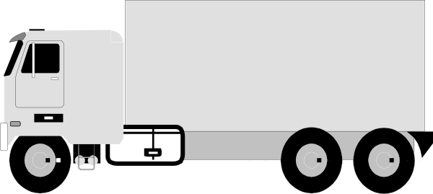
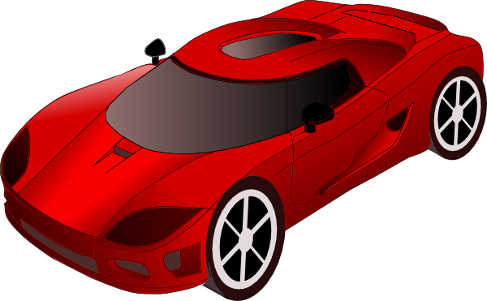
Inheritance Example
Truck.java
Car.java
Vehicle.java
2016 Winter Prepared by Berk Soysal for ITI1121A

Slide 4
Swing is a GUI widget toolkit for Java. It is part of Oracle's Java Foundation Classes (JFC) – an API for providing a graphical user interface (GUI) for Java programs. Swing was developed to provide a more sophisticated set of GUI components than the earlier Abstract Window Toolkit (AWT).
Java Graphical User Interface (GUI)
2016 Winter Prepared by Berk Soysal for ITI1121A

Slide 5
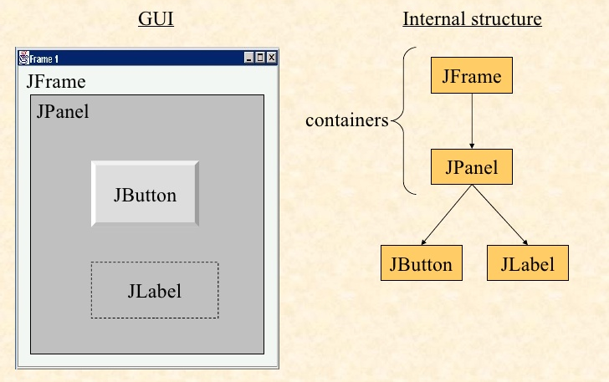
Anatomy of an Application GUI
JFrame: a heavy-weight container used as the top-level window.
JPanel: a light-weight container used to organize GUI components.
2016 Winter Prepared by Berk Soysal for ITI1121A

Slide 6
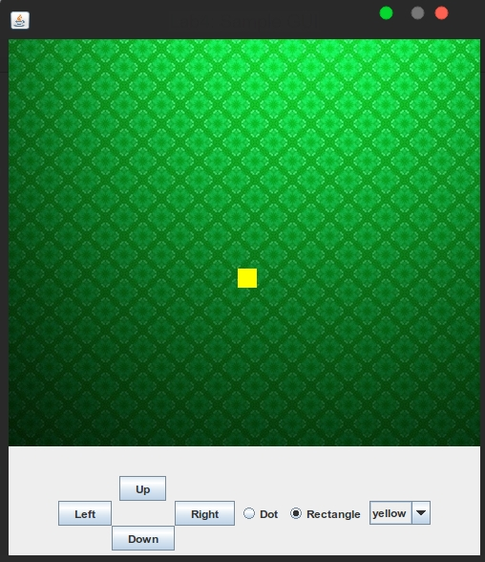
Let’s Create a GUI !
2016 Winter Prepared by Berk Soysal for ITI1121A

Slide 7
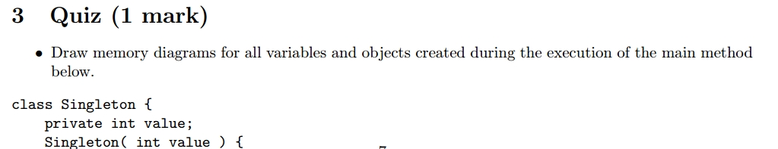
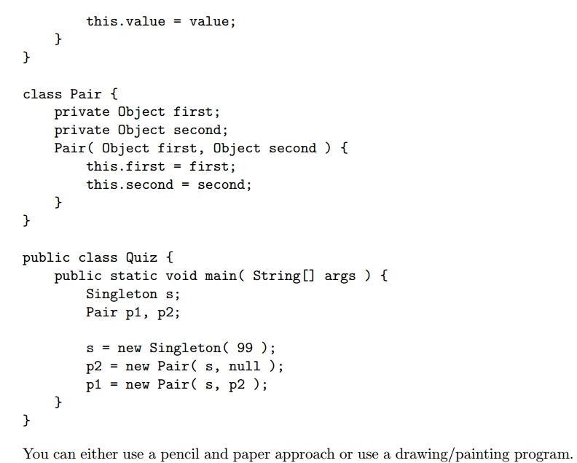
Submit Your Quiz Answer(as an image) & Codes in a zip file and in a single submission to BlackBoard.
2016 Winter
Download this ppt. - http://uottawa.ml

